Slide 1
Digital Image Processing in Python
Marcus Gallagher-Jones – marcusgj13@gmail.com
Day2
11/07/2018
https://github.com/marcusgj13/W21.DigitalImageProcessing

Slide 2
Day 2 overview
Today we will introduce scikit-image, a python library containing a variety of useful functions for dealing with images.
Alongside this we will learn which are the most likely tools to be useful when tackling an image processing task.
We will cover preprocessing: histogram equalization, Fourier transforms and filtering/denoising.
And postprocessing: Edge detection, thresholding, segmentation, morphological opening/closing, masking and ROI extraction.

Slide 3
Before we begin a note on imaging
Ultimately image processing will only be as good as the images going in.
We can correct some experimental errors but not all so be careful that your imaging setup is suitable for your needs (where possible of course).
Always be aware of things like uneven lighting, staining strategies, vibrations etc. that can degrade image quality.

Slide 4
Scikit-image
Scikit-image puts together a large number of functions/algorithms that are necessary for most image processing endeavors.
It is built over numpy and scipy making it easy to use with other code.
The main goals of it’s development are stated as follows:
To provide high quality, well-documented and easy-to-use implementations of common image processing algorithms.
To facilitate education in image processing.
If you are interested in learning more about it’s development look here: Van der Walt et al. (2014), PeerJ, DOI 10.7717/peerj.453

Slide 5
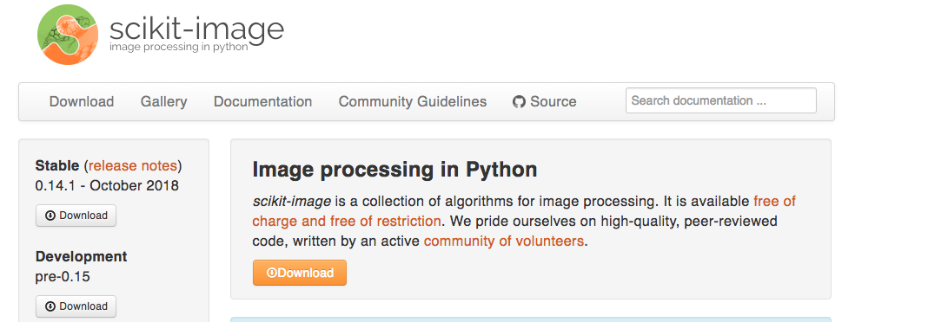
Scikit-image

Slide 6
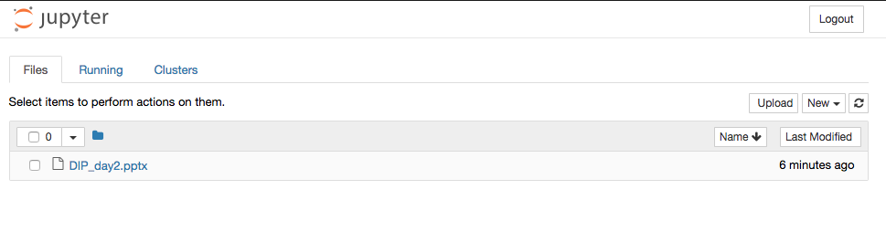
Let’s get started by opening up a new notebook

Slide 7
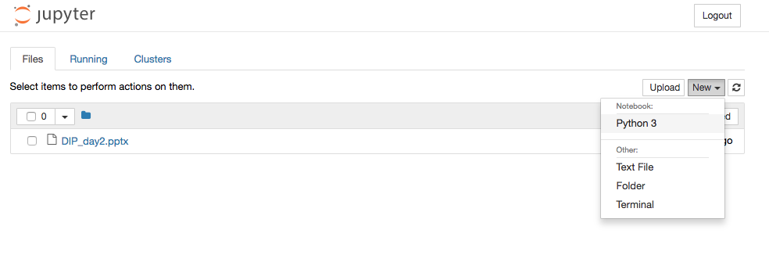
Let’s get started by opening up a new notebook

Slide 8
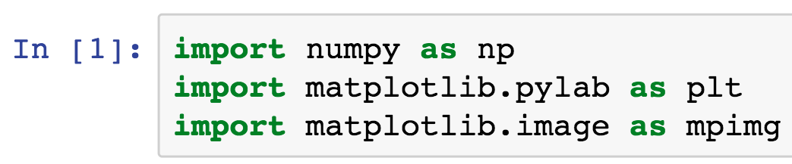
Import relevant libraries

Slide 9
Image preprocessing

Slide 10
Preprocessing – why do we need to do this?
Preprocessing is the process by which images are modified to maximize the amount of useful information that can be extracted.
Generally the devices used to collect images are imperfect.
Images can be corrupted by uneven illumination, differential response of pixels, electronic noise etc.
Preprocessing is the process of removing as much of that error as possible before moving forward with analysis.

Slide 11
Test images in skimage
Scikit-image comes with its own library of test images. We will be using these extensively today as we go through examples.
We will start with the coins data set.

Slide 12
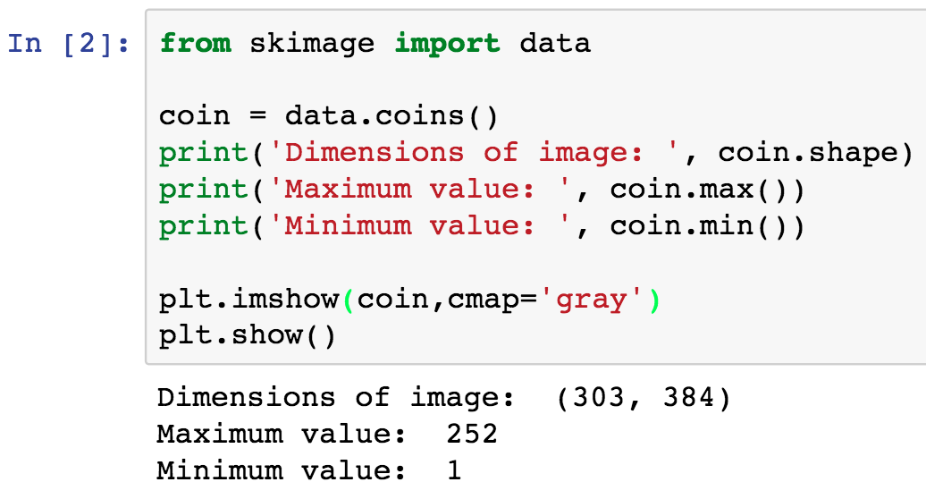
Test images in skimage

Slide 13
Test images in skimage
It’s a good habit to inspect the properties of images once imported.

Slide 14
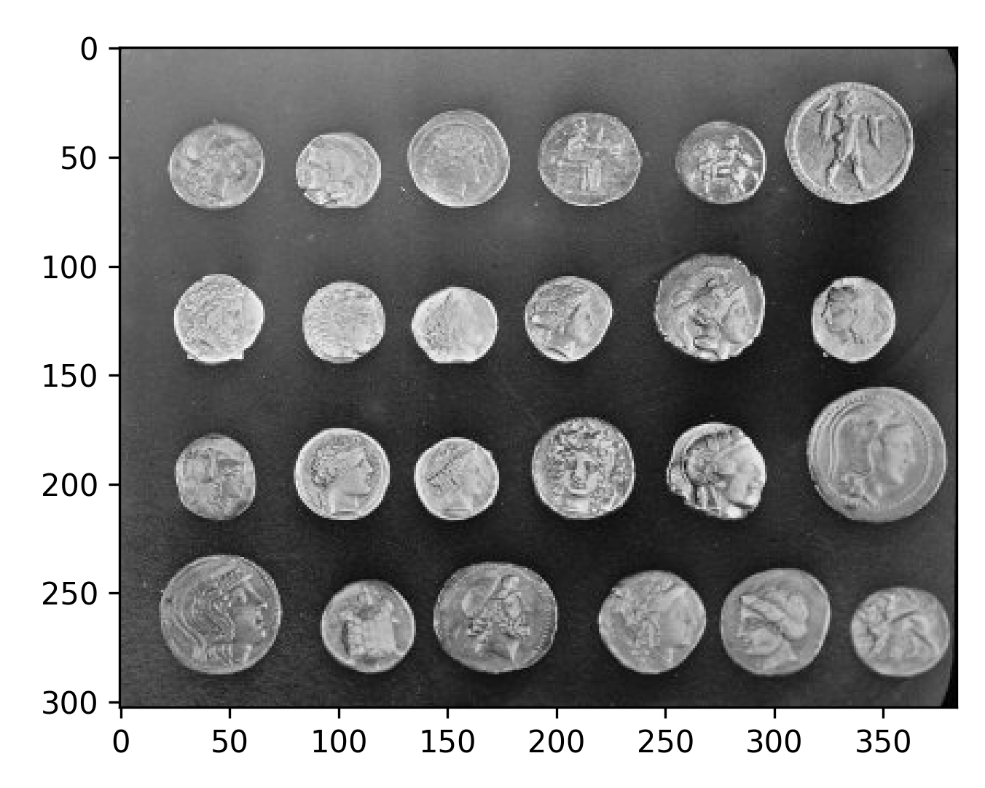
Test images in skimage

Slide 15
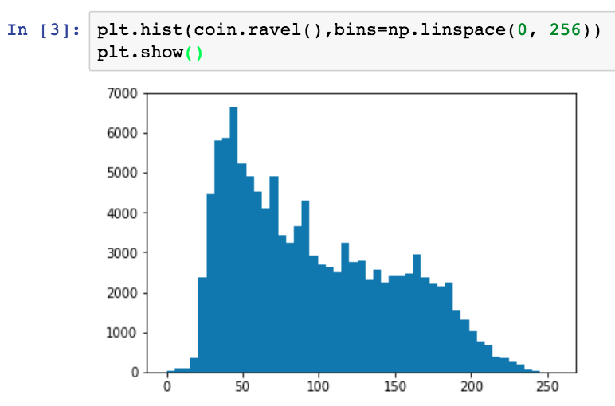
Inspecting image histograms

Slide 16
Inspecting image histograms
Histograms are a quick way of assessing if anything is weird with an image.

Slide 17
Histogram equalization
This is a method of enhancing contrast in an image when signal is focused within a small range of values.
Histogram equalization aims to correct this by reshuffling values within the image such that there are a more even number values in each histogram bin.
This has the effect of enhancing contrast and can also correct uneven background.
We can do this globally or locally (adaptive histogram equalization).

Slide 18
Histogram equalization

Slide 19
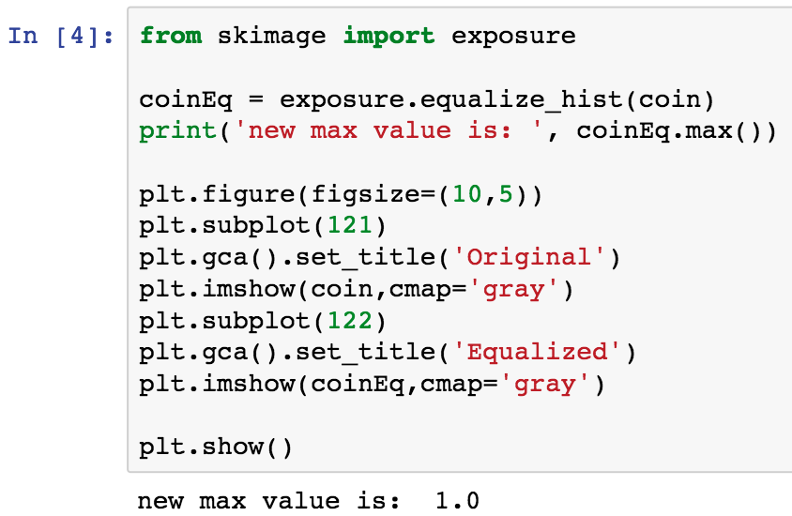
Histogram equalization

Slide 20
Histogram equalization
The exposure sub library contains a lot of useful tools for adjusting image contrast.

Slide 21
Histogram equalization
Remember we use a period to access subfunctions from within a library.

Slide 22
Histogram equalization
Here we use subplots to display the original and results side by side for easy comparison.

Slide 23
Histogram equalization
Note the change here. Skimage prefers the data to be in different formats for particular functions so the values of your data may be changed.

Slide 24
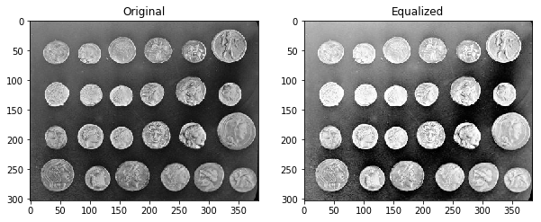
Histogram equalization

Slide 25
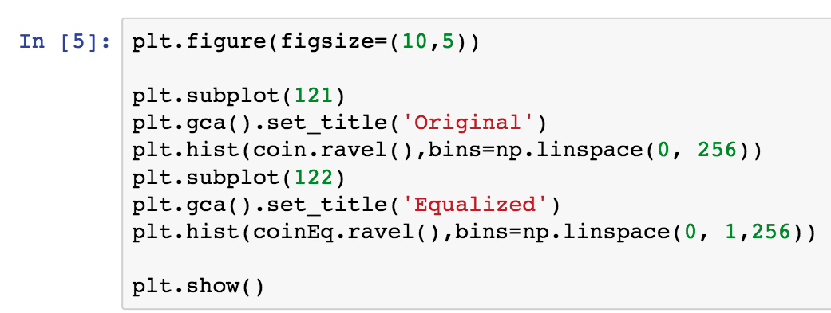
Histogram equalization

Slide 26
Histogram equalization

Slide 27
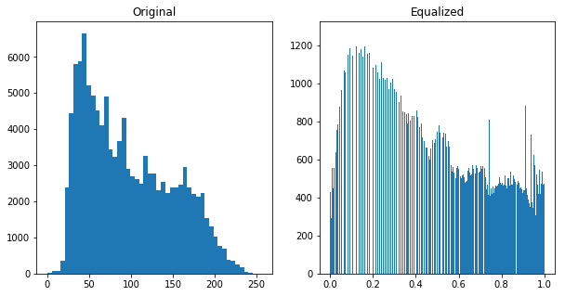
Histogram equalization

Slide 28
Adaptive histogram equalization
The previous algorithm works on the image globally.
This might not always be the best strategy as you can see.
Adaptive histogram EQ enhances contrast by altering the histogram of local regions of the image.
This can give better results when you have regions of localized intensity.

Slide 29
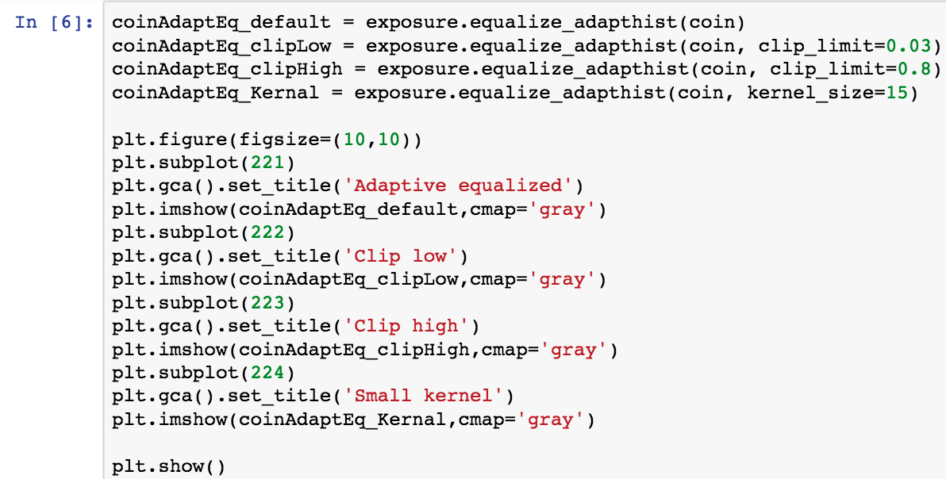
Adaptive histogram equalization

Slide 30
Adaptive histogram equalization
The two main paramaters are the kernel size, which defines how big of a region to do local histogram adjustment, and clip limit, which determines he height of any given histogram.

Slide 31
Adaptive histogram equalization
Illustration of clip limit

Slide 32
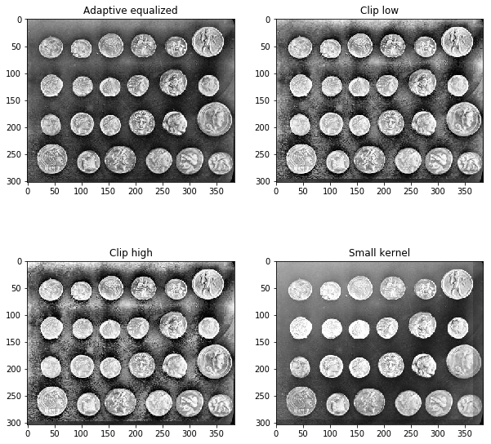
Adaptive histogram equalization

Slide 33
Fourier transforms and filtering
The goal of filtering is to isolate particular components of an image and either enhance of remove them.
Typically this is performed by convolution with a kernel.
Convolution is a pixelwise operation and can be very slow.
Alternatively we can exploit Fourier transforms to perform these operations in the frequency domain.
This makes use of something known as convolution theorem.

Slide 34
Convolution theorem and frequency space
The Fourier transform is a means of representing a function as a series of sine and cosine waves.
In Fourier representation, each pixel contains information from all pixels in the image it was calculated from.
This means that if we modify a single pixel in the Fourier transform of an image, we modify all pixels in the image.
So if we multiply the Fourier transform by a function, the whole image will be modified by that function.

Slide 35
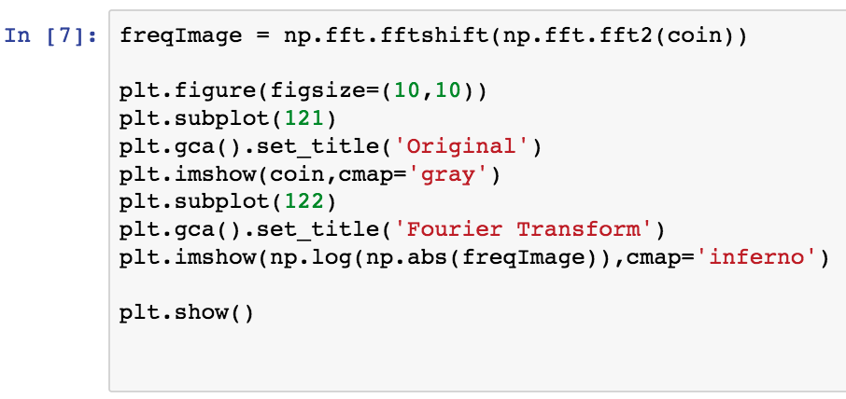
Taking the Fourier transform of an image
We can access the Fourier transform via numpy’s fft library.

Slide 36
Taking the Fourier transform of an image
Here we are using the 2D fft (our image is 2D) as well as fftshift to make sure the lowest frequency term is at the centre of the image.

Slide 37
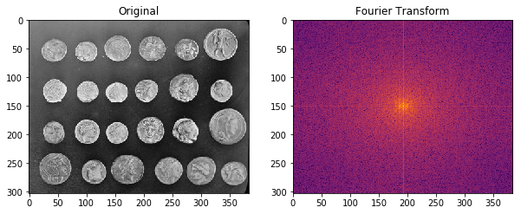
Taking the Fourier transform of an image

Slide 38
Filtering in the Fourier domain
As we move out radially from the centre of a Fourier transform we are increasing in resolution.
By modifying pixels at a certain resolution from the centre of the transform we can therefore alter the resolution of the image, or features of a certain resolution.
A low pass filter is one where the low resolution components ‘pass’ and the higher resolution components are blocked.
A high pass filter does the converse – emphasizing high resolution features.

Slide 39
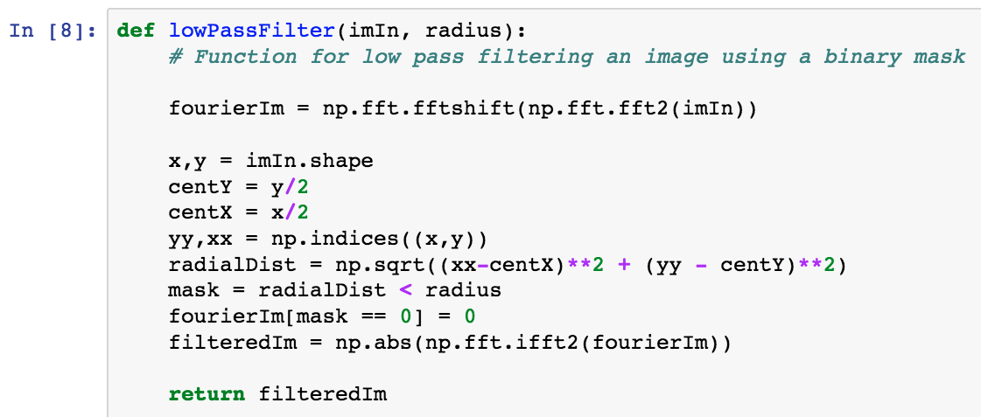
Low pass filter
This is the radial function from yesterday. We will use it to define a mask

Slide 40
Low pass filter
Using the mask we block all values above a certain spatial frequency.

Slide 41
Low pass filter
We then return the absolute value (FFT introduces an imaginary component).

Slide 42
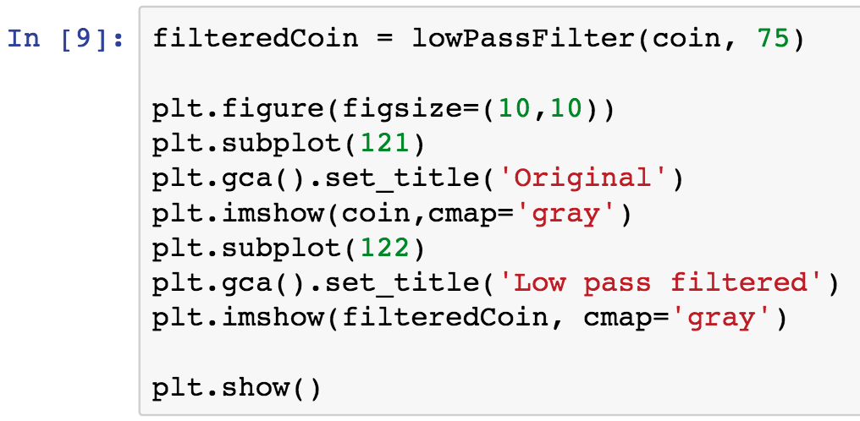
Low pass filter

Slide 43
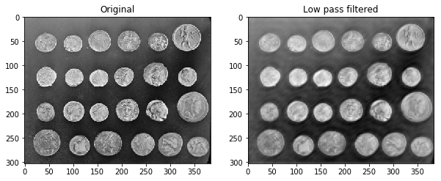
Low pass filter

Slide 44
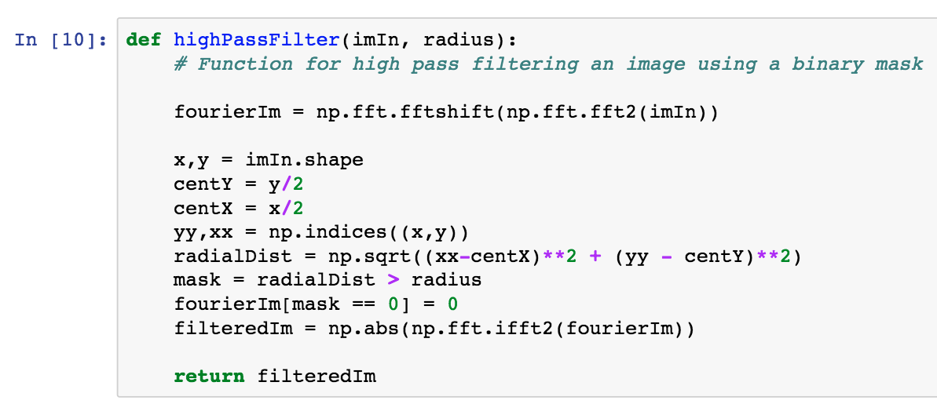
High pass filter

Slide 45
High pass filter
This function is almost exactly the same but the mask is inverted

Slide 46
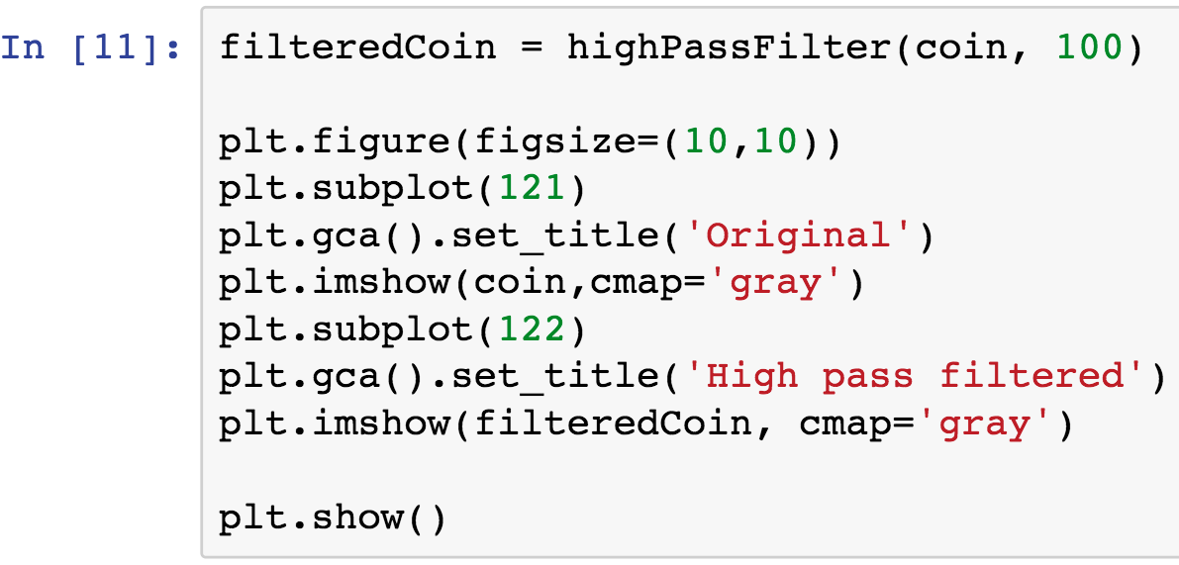
High pass filter

Slide 47
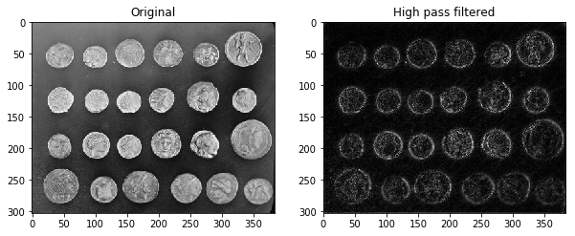
High pass filter

Slide 48
Other filters
Skimage has a large number of other filters which have a variety of functions.
Some are good for removing noise and emphasizing large objects (gaussian, median, mean)
Others are good for enhancing edges (Laplacian, sobel, canny).
These typically involve more complicated kernels than those we defined ourselves.
We’ll go over a few examples but definitely try others yourself.

Slide 49
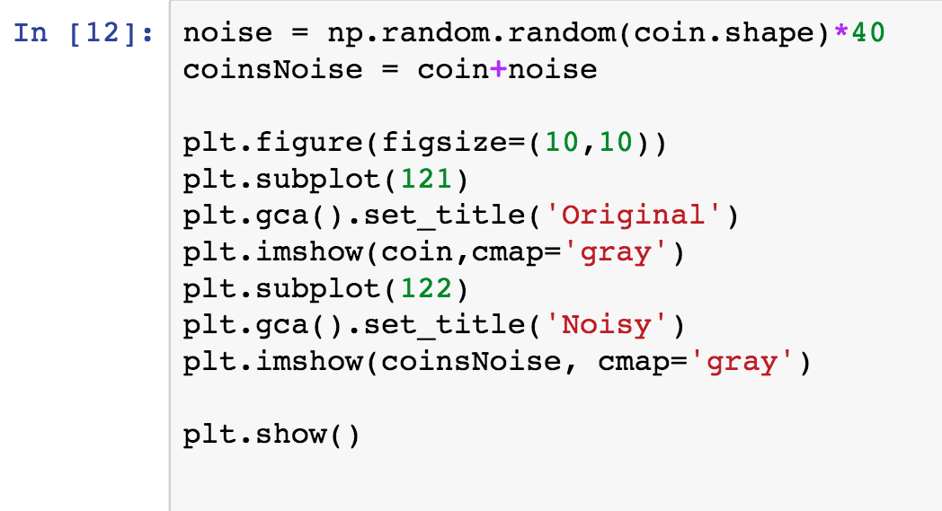
Other filters – first we’ll create a noisy image

Slide 50
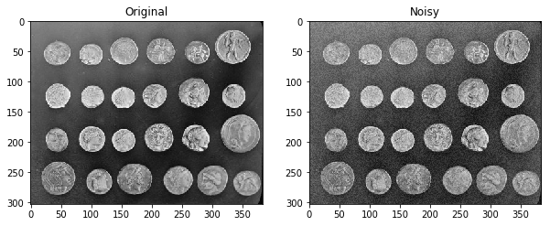
Other filters – first we’ll create a noisy image

Slide 51
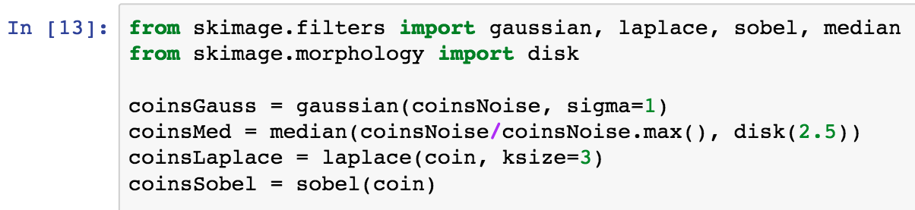
Other filters – import relevant filters and apply them to image

Slide 52
Other filters – import relevant filters and apply them to image
Disk is a structural element, we’ll discuss this later

Slide 53
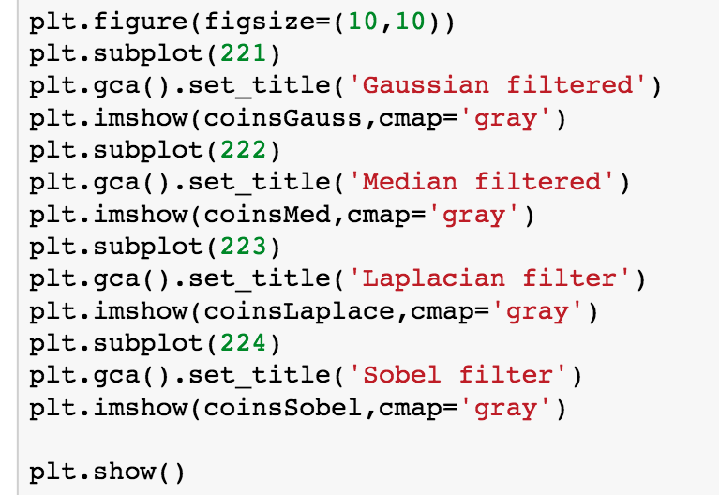
Plot the results

Slide 54
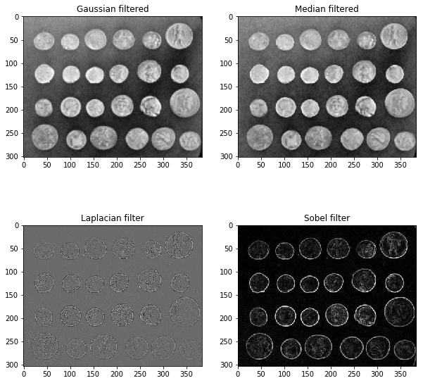
Plot the results

Slide 55
More advanced denoising
So far we have seen how we can use some basic filters to remove noise.
These aren’t ideal however as they do come at the cost of resolution.
More advanced denoising methods are available in Scikit-image which take advantage of local information to remove noise.
These algorithms better preserve edges and sharp features.

Slide 56
More advanced denoising
Total variation denoising seeks to decrease the total variation in a local region of the image – large changes in values likely due to noise.
The important parameters for TV are the denoise weighting (larger = more denoising but loss of fidelity) and number of iterations.
Non local means attempts to reduce noise by changing pixel values to be equal to the mean of local related patches.
NL means requires an estimate of the standard deviation (sigma) of the noise.
The patch size and a cutoff value also need to be specified.

Slide 57
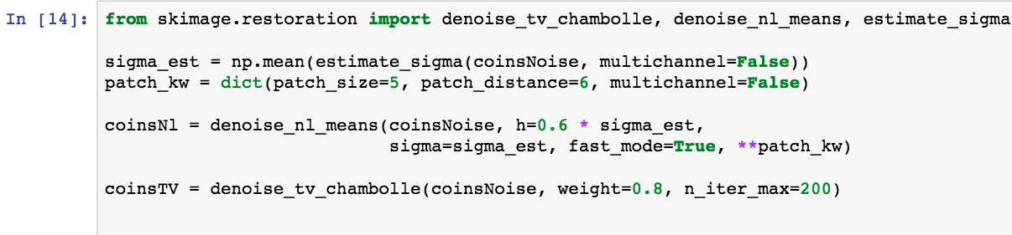
More advanced denoising

Slide 58
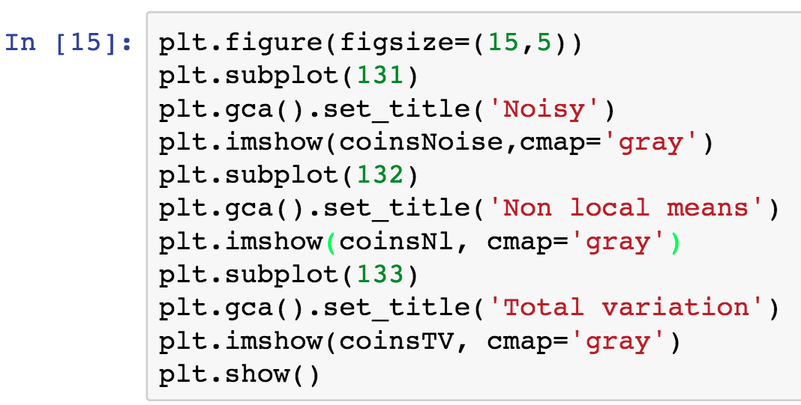
More advanced denoising

Slide 59
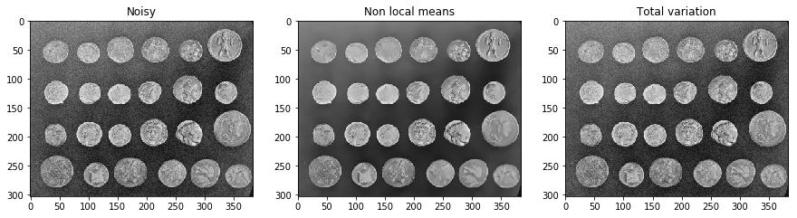
More advanced denoising

Slide 60
Wrapping up preprocessing
The goal of this stage is to maximize the useful signal in an image.
We generally want to reduce noise to improve the quality of information extracted from pixels.
We can use a variety of filters to enhance particular features for extraction/segmentation.
More advanced denoising algorithms can be used however they do require some hyper parameter tuning, i.e. not necessarily general.

Slide 61
Segmentation and feature extraction

Slide 62
Thresholding
Thresholding is the most basic way to segment an image.
This is simply stating that all pixels below a single value are background and everything above is a feature of interest.
Estimation of a threshold can be done in a number of ways (either global or local)
One of the most popular ways is using Otsu’s method which assumes the distribution of pixels is roughly bimodal (background and signal).
We’ll start with the image we created by histogram equalization.

Slide 63
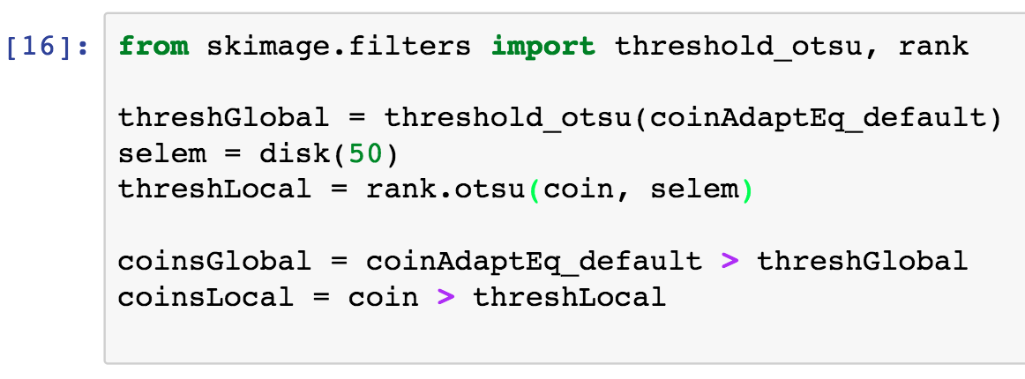
Thresholding using Otsu’s method

Slide 64
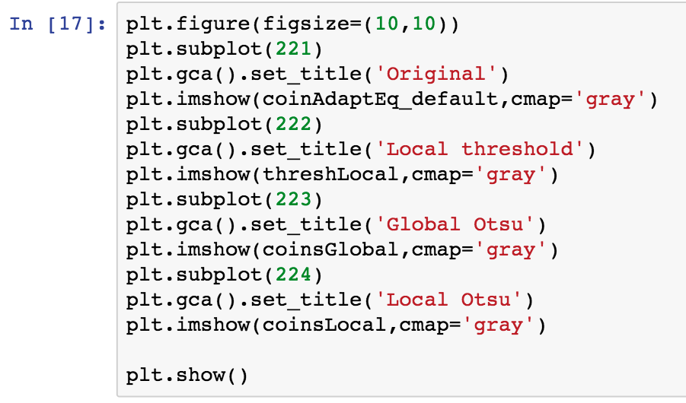
Thresholding using Otsu’s method

Slide 65
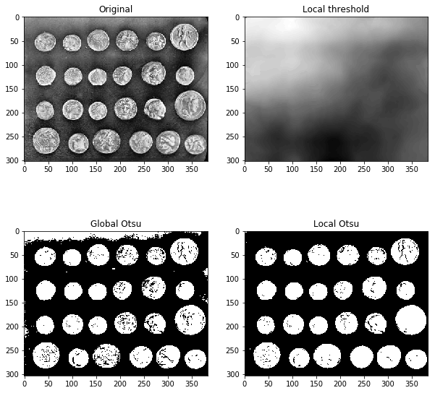
Thresholding using Otsu’s method

Slide 66
Thresholding using Otsu’s method
The local threshold does a good job of estimating the structure in the background.

Slide 67
Thresholding using Otsu’s method
Since the coins are well separated we should be able to segment from the binary image alone.

Slide 68
Segmentation from a binary image
In cases where there is high contrast and well separated objects it is possible to segment from a binary mask directly.
To do that we will need to clean it up a little bit using morphological opening/closing.
This process will define a ‘structural element’ (some shape of size mxn in pixels) and use it as a feature to expand/contract regions in a binary image.
In this case we are using functions to fill holes and remove objects bigger/smaller than 64 pixels.

Slide 69
Morphological modification by structured elements.

Slide 70
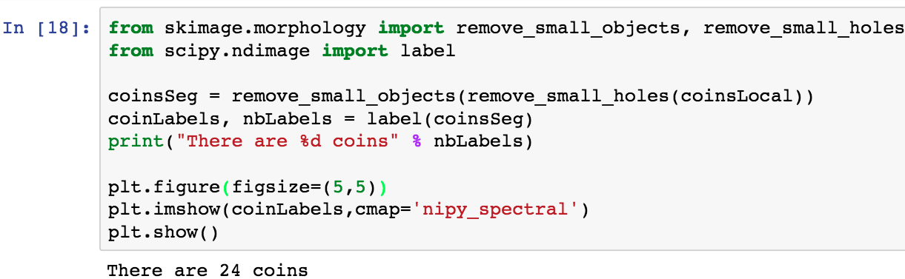
Segmentation from a binary image

Slide 71
Segmentation from a binary image
The label function looks for distinct, contiguous objects and assigns them a value.

Slide 72
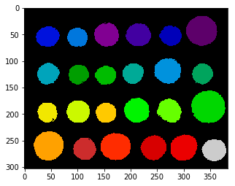
Segmentation from a binary image
Not bad for a first pass. It looks like some of the edges are a bit poorly defined however.

Slide 73
Segmentation using edge detection
For objects that are quite well separated such as the coins sometimes edge detection can perform better than a simple threshold.
We will use the sobel filter from earlier in conjunction with the watershed algorithm for creating the segmentation.
This should hopefully give a better boundary around the coins.

Slide 74
Segmentation using edge detection
For objects that are quite well separated such as the coins sometimes edge detection can perform better than a simple threshold.
We will use the sobel filter from earlier in conjunction with the watershed algorithm for creating the segmentation.
This should hopefully give a better boundary around the coins.
To do this we have to specify markers as a starting point for the watershed “flooding”.

Slide 75
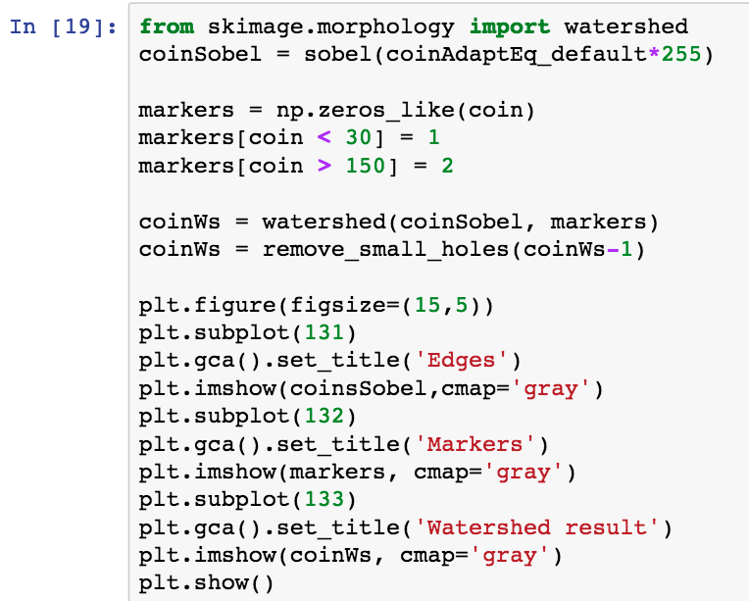
Segmentation using edge detection

Slide 76
Segmentation using edge detection
Here we define the foreground and background regions which are the starting point for the segmentation.

Slide 77
Segmentation using edge detection
Again the segmentation is slightly incomplete so we use morphological closing to fill any holes.

Slide 78
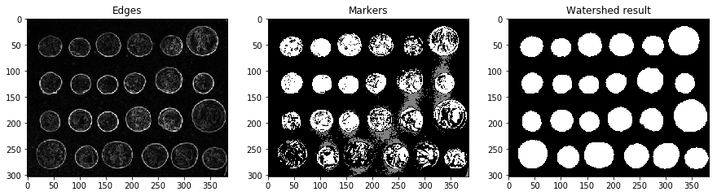
Segmentation using edge detection

Slide 79
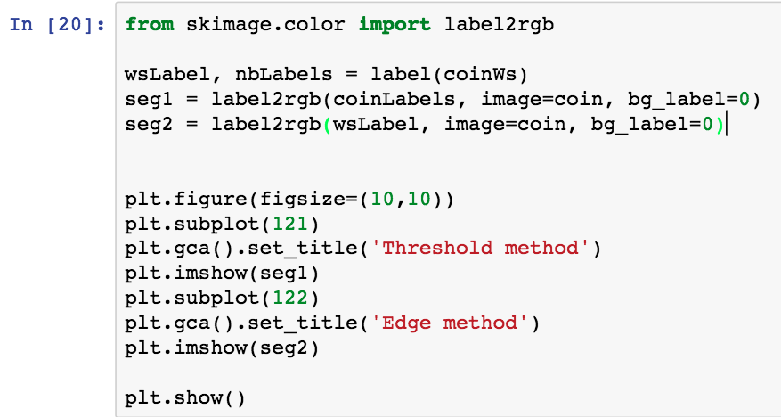
Let’s compare the two methods
Label2rgb allows us to overlay the labels from segmentation onto an image.

Slide 80
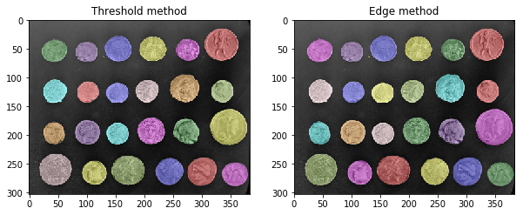
Let’s compare the two methods

Slide 81
A real world example
The coins model is a little straightforward.
This example is more close to imaging data you may encounter from photos.
We will load this multichannel image and try our best to segment a feature from a non-uniform background.
This will use a combination of several filters we have already learned about.

Slide 82
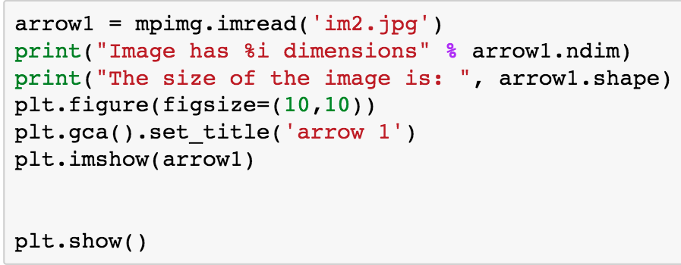
Load the arrowhead image

Slide 83
Load the arrowhead image
Remember to always check the dimensions of the image.

Slide 84
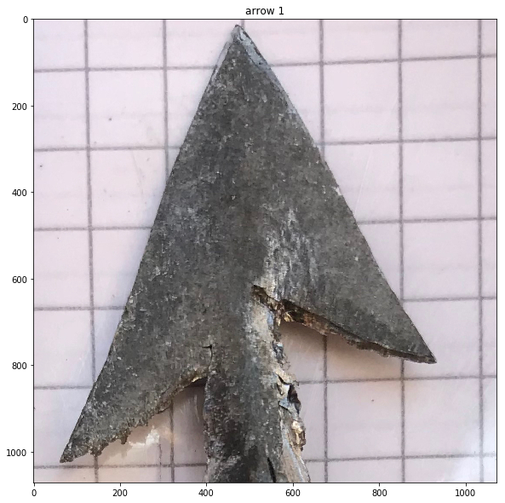
Load the arrowhead image

Slide 85
Load the arrowhead image
This image has a featured background so may need so preprocessing before segmentation can occur.

Slide 86
Load the arrowhead image
Also note that the illumination is not quite consistent so we can’t make use of simple thresholds.

Slide 87
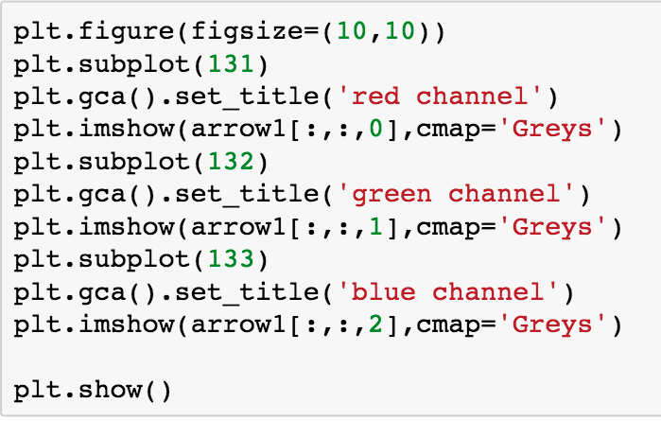
Inspecting the color channels

Slide 88
Inspecting the color channels

Slide 89
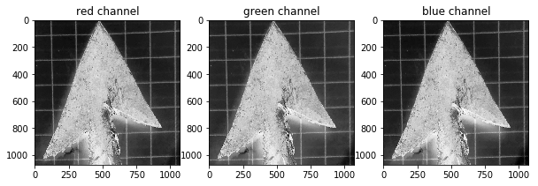
Inspecting the color channels

Slide 90
Inspecting the color channels
Doesn’t look as though the arrow can be quickly separated in any one particular channel.

Slide 91
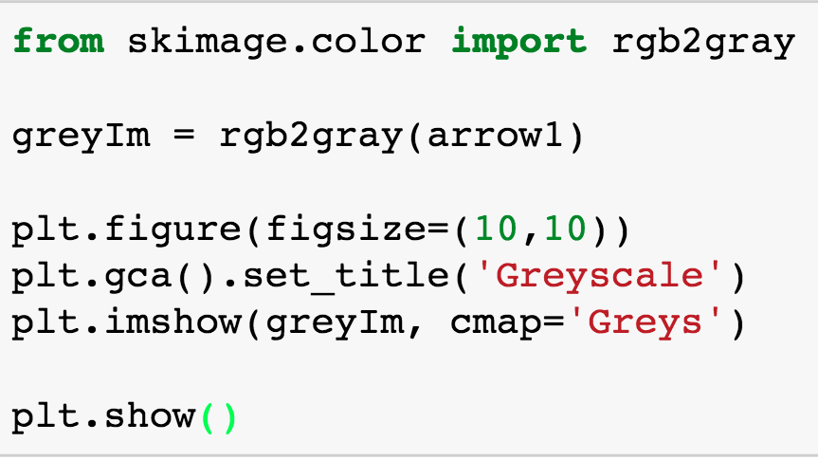
Convert the image to greyscale

Slide 92
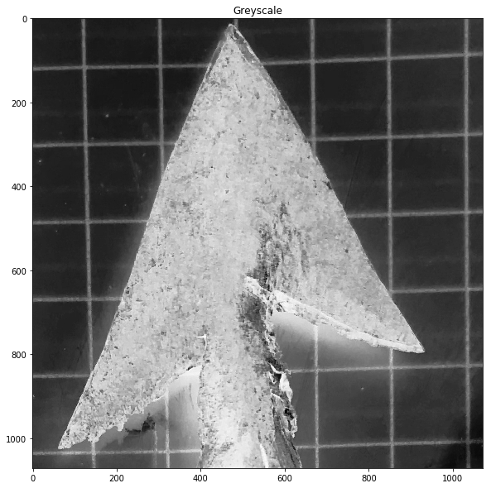
Convert the image to greyscale

Slide 93
Convert the image to greyscale
The first issue we will need to address is the structure in the background.

Slide 94
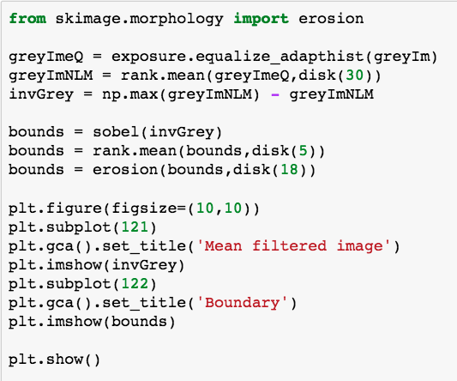
Filtering to remove the grid

Slide 95
Filtering to remove the grid
First we will try and make the background as flat as possible.

Slide 96
Filtering to remove the grid
Here we use a mean filter with quite a large structure element to remove the grid.

Slide 97
Filtering to remove the grid
Finally we use a sobel filter to detect the edges, use a mean filter to make them continuous and erode the boundary image to make the boundary thin.

Slide 98
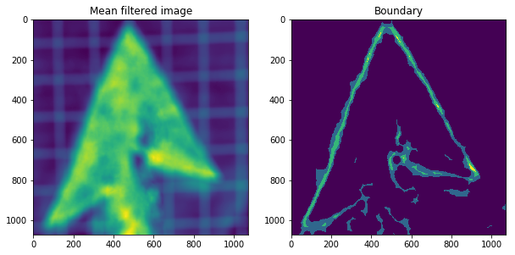
Filtering to remove the grid

Slide 99
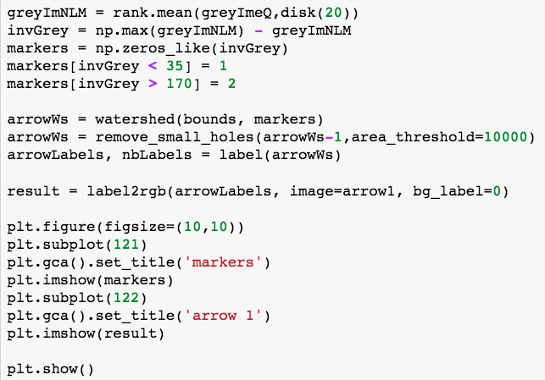
Watershed to isolate the arrowhead

Slide 100
Watershed to isolate the arrowhead
Create a new mean filtered image with slightly less smoothing.

Slide 101
Watershed to isolate the arrowhead
Use this to define markers for the foreground (arrowhead) and background (everything else).

Slide 102
Watershed to isolate the arrowhead
Segment using watershed and fill in any holes that exist. Allow for large holes since the image is also quite big.

Slide 103
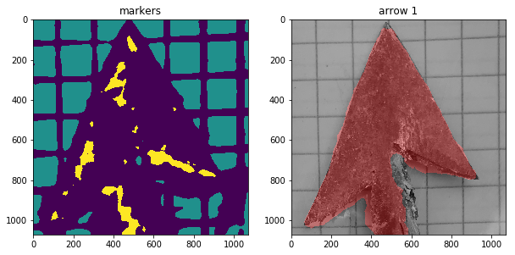
Final result

Slide 104
Summary for day 2
We have covered some of the basic steps of preprocessing and segmentation.
We have learned how the Fourier domain can be used for rapid filtering of image.
We have covered some of the other common filters.
Introduced two more advanced denoising algorithms.
Worked through segmentation by two different methods (thresholding and edge detection)

Slide 105
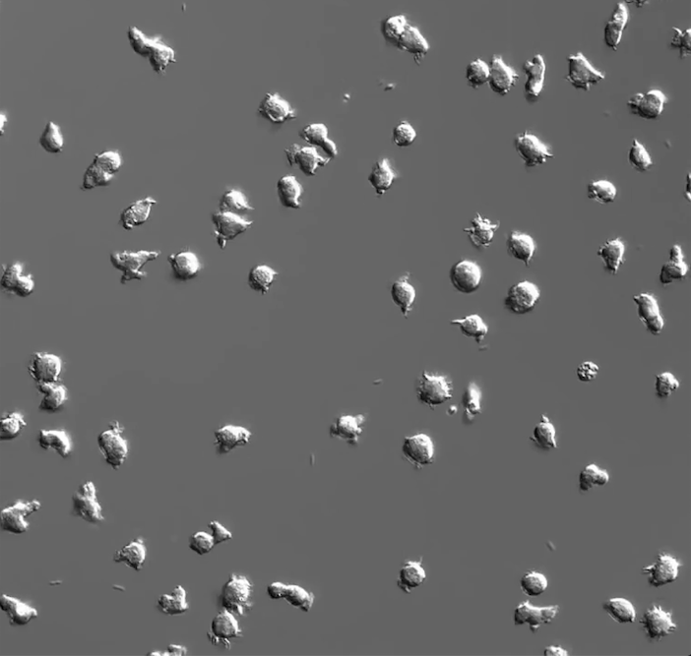
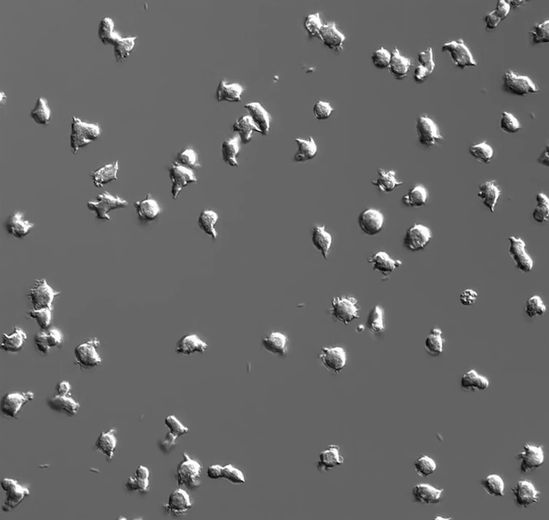
Coming up on Day3
Cell segmentation and tracking

Slide 106


For more information
http://web.ipac.caltech.edu/staff/fmasci/home/astro_refs/Digital_Image_Processing_2ndEd.pdf
http://programmingcomputervision.com/

